Slide 1

Yelp Recommender System
CSYE 7200 Final Project
Team 9: Zenan Lin | Yiqiang Wang | Wen Zhong

Slide 2
Background
In today’s information ear, information overload is inevitable
People are hard to distinguish useful information
Producer are rarely get attention from users
So, a recommender system is shown to solve this dilemma
Valuate user’s information and recommend some similar product they might interested
Product display to who needs it

Slide 3

Use Case
In this scenario, we will implement a recommendation system that recommend restaurants for each user, based on his or her consumption rating records.
Based on the records (considered as dataset), we take preference of every user for each restaurant. User may rate from different degrees when considering if it is tasty or cheap. We take all ratings into a formula and get a rating point. Now we have a data frame with [user, item and rating].
The algorithm ALS we use takes a standard dataset. And its output will fill all blanks that restaurant doesn’t rated by any user. As a result, we’ll have either origin or prediction a value that every user rates for a restaurant.
So, we can easily get the top N restaurants that have highest scores for each user. If we combine this recommendation list with distance and rating time, we’ll have an advanced list which is our final output.
Notes:
explicit feedback,

Slide 4
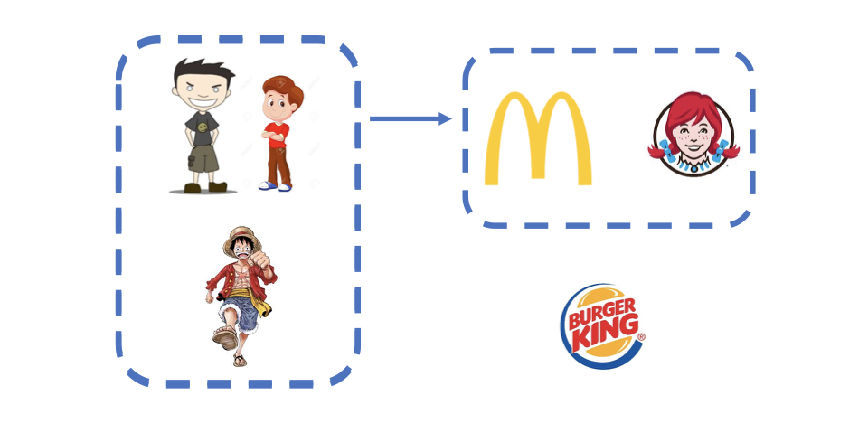
Scenario

Slide 5
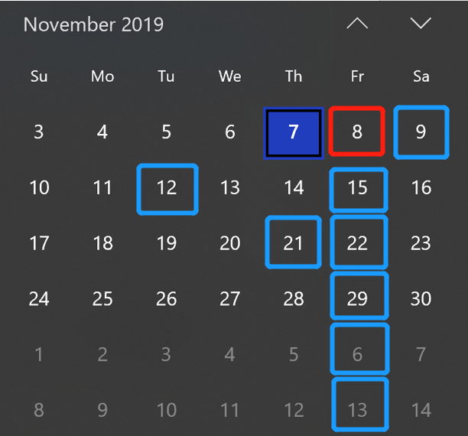
Timeline - Yelp Recommender System
Goals：To design a recommender system based on user’s preference
We are here
Planning
Implementing
Verification
Done!!
11-12 Obtain processed data
11-12 Obtain
processed data
Challenge1: Choose
appropriate algorithm
11-09 Pre
-clean data
11-21 Initial result
11-26 Initial visualization
11-29
Wrap-up
11-08 Build planer
11-15 Testing algorithm
11-22
Applying API
Challenge2: Make a
nice visulization
12-06
Final check
11-15 Testing algorithm
11-08
11-12
11-15
11-21
11-22
11-29
12-06
12-13
2019/11/08 | 2019/11/09 | 2019/11/12 | 2019/11/15 | 2019/11/21 | 2019/11/22 | 2019/11/26 | 2019/11/29 | 2019/12/06
Build planer; Schedule tasks. | Process data; Clean no need features. | Should have clean data; Ready to test on algorithm | Testing on the algorithm; Choose an appropriate one. | Get initial result after running algorithm. | Importing API into project. | Initial visualization. | Almost done; Verify the project and reorganize to clean project. | Done!! Have a final check with everything.
Milestone
Completed
In-Progress
To-dos
Challenge
Current progress

Slide 6
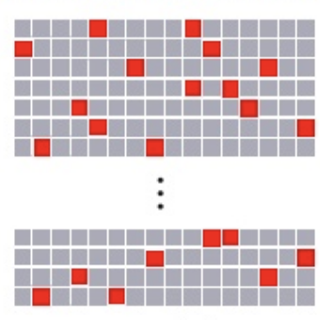
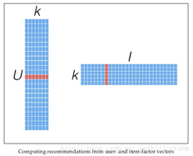

Code
Project repsotpry: https://github.com/NeilLin85/CSYE7200_yelp_recommend
We implement ALS model for recommendation
The code will be in 3 parts: Data cleaning, Model running and Result generating

Slide 7
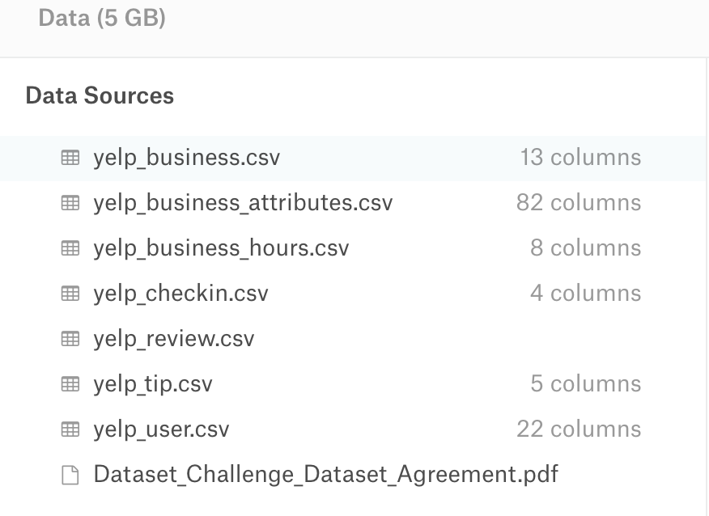
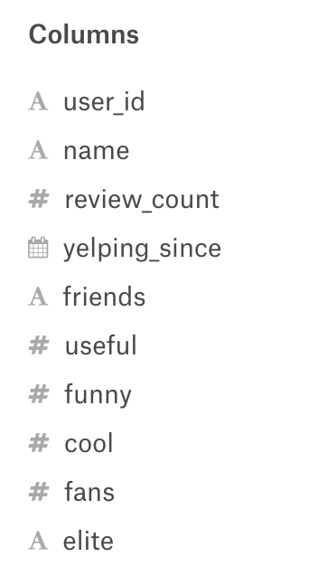

Datasets
Original Data:
5,200,000 user reviews
Information on 174,000 businesses
Yelp Dataset: https://www.kaggle.com/yelp-dataset/yelp-dataset
What we need:
user: review, restaurant, star, funny, useful
restaurant: id name city/state location

Slide 8
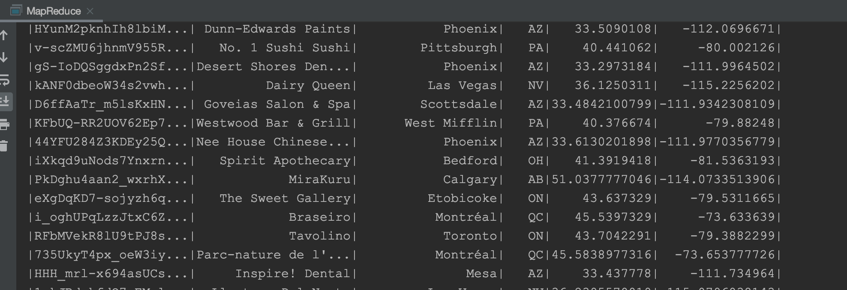
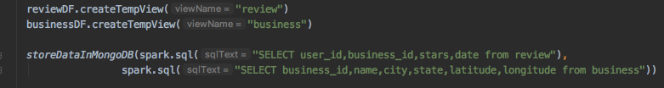
Data loading
use spark.sql, read as dataframe

Slide 9
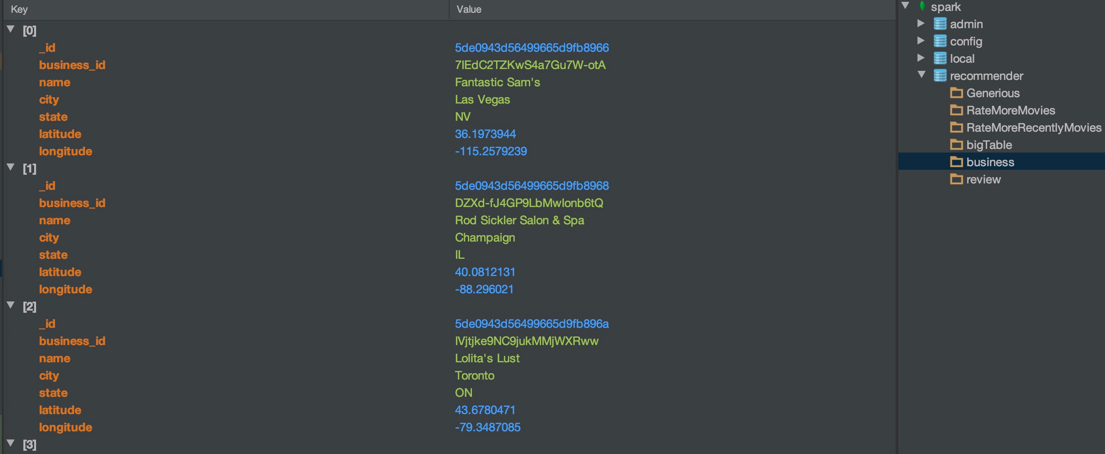
Data stored into MongoDB

Slide 10
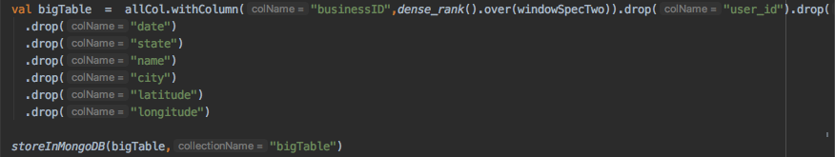
Data prep
Load data from MongoDB, merge rating and business into one table with business_id
Change format of input data in table just create (userId, businessId, rating)
Each of our target business will be an int corresponding number to which we want to associate ratings.
Finally, store into MongoDB

Slide 11
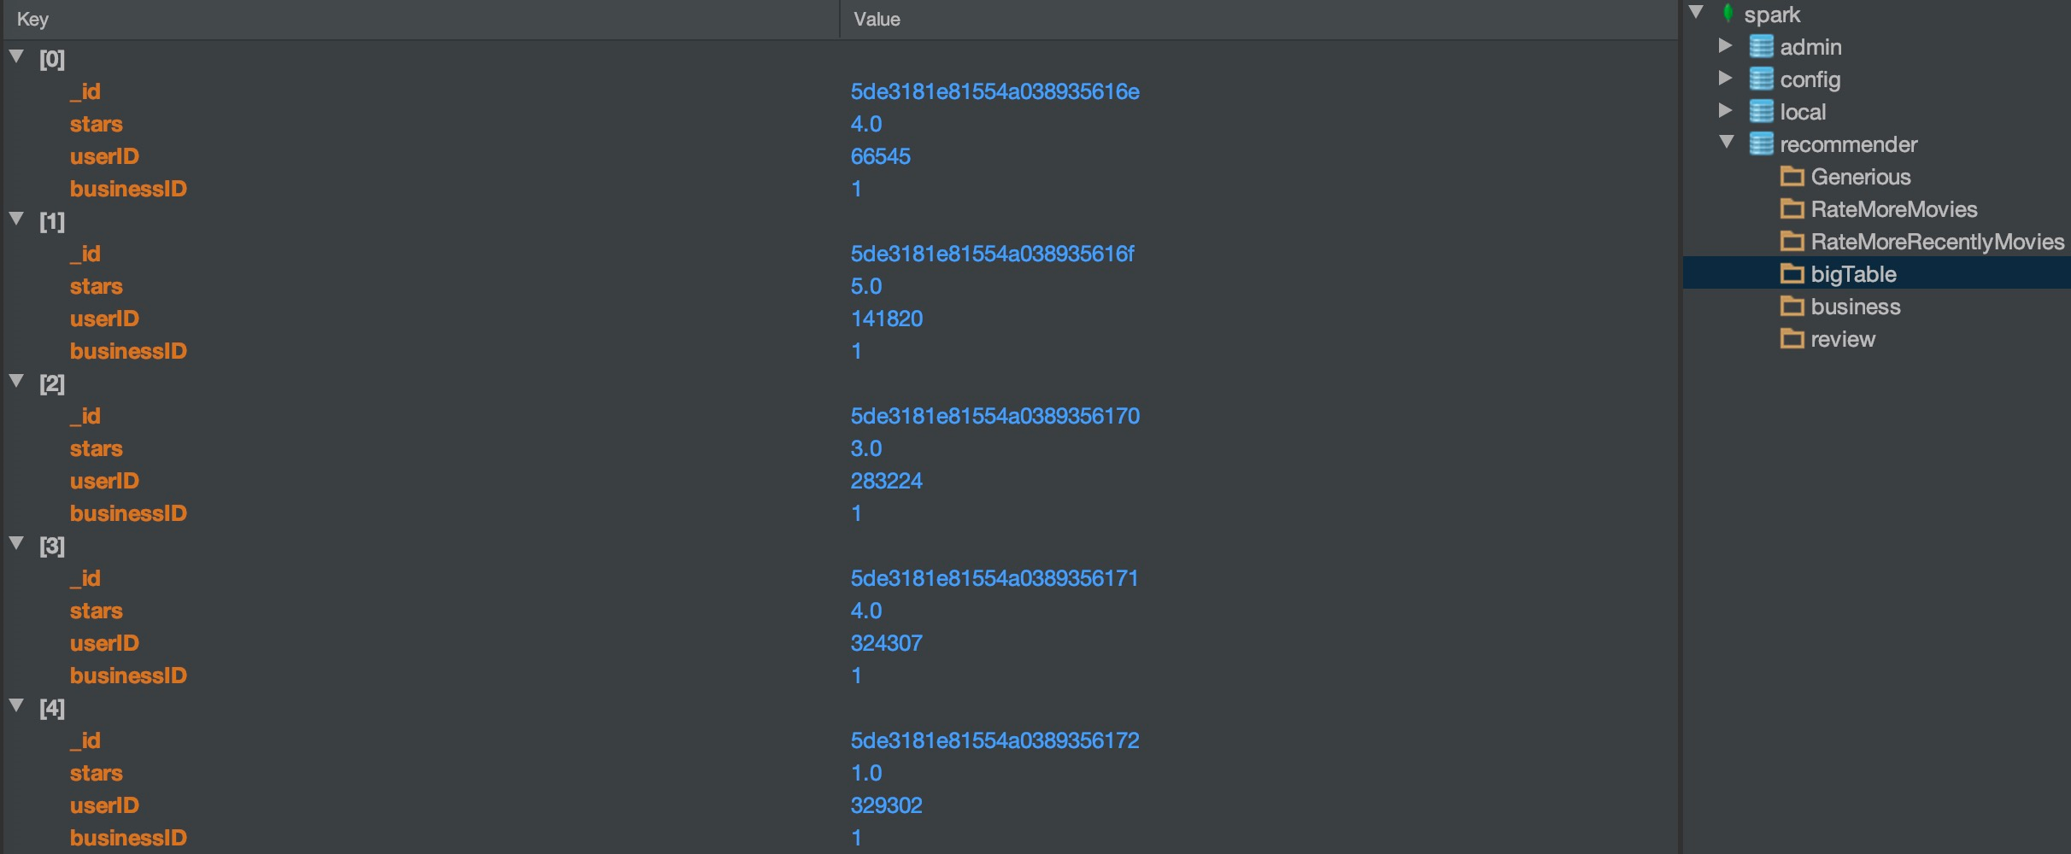
Data stored in MongoDB

Slide 12

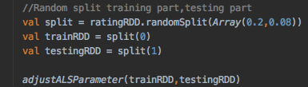
Methodology
Generating training set as the table below
Recommend point = rating + price + distance (filtered by distance, ordered by point)
rating = (star * weight1 +... + useful*weightN) * weightT
We use the 80 percent of data to make the fill matrix, and using the 20 percent of the data to test.
Based on this recommendation system, we recommend 10 restaurants to the user. And using the test data calculate the top 10 rating restaurant.
Generating recommendation list
Show result: recommendation list for each user
User | Item | Rating
user1 | restaurant1 | 2
user2 | restaurant1 | 4

Slide 13
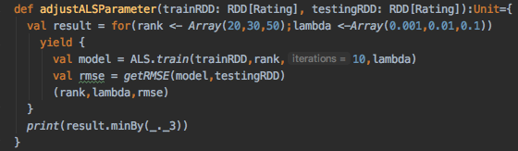
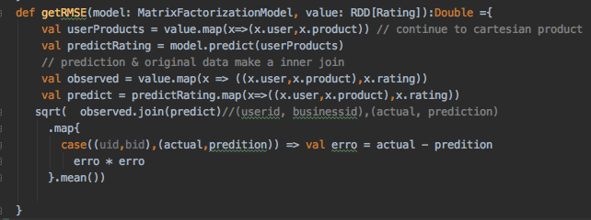
Continued...
Find the smallest RMSE;
The smallest would be the optimal choice
Apply the parameter into our model

Slide 14
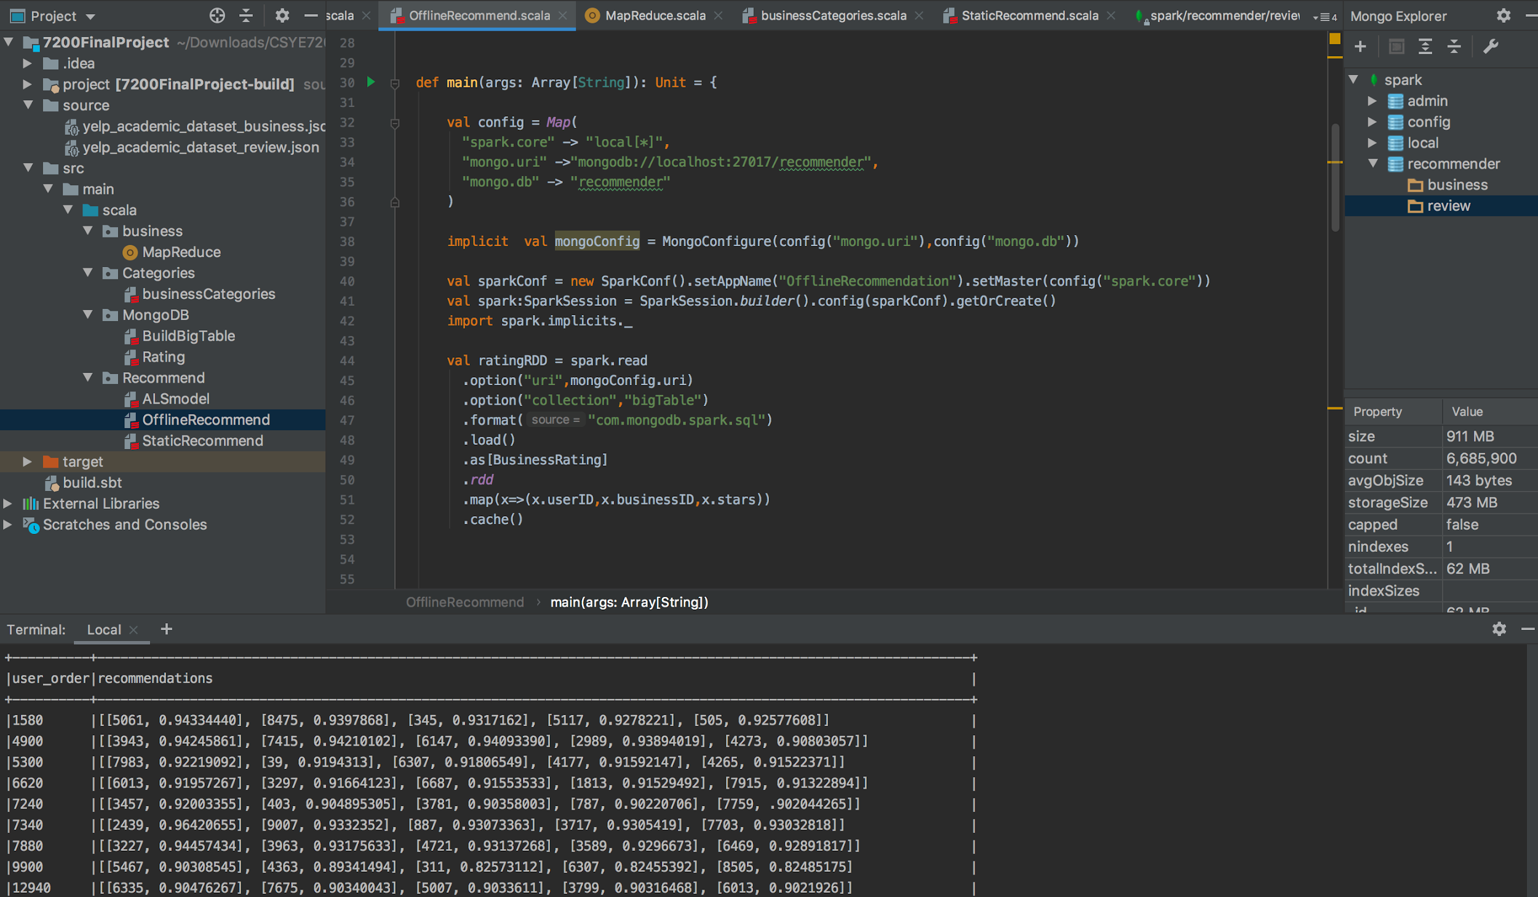
Implementation Code goes here...

Slide 15

Goals
For each user recommend items from different categories. List = n1 from categories + n2 from categories + n3 from categories 3 + …(n1 + n2 + n3 + … = recommendation list count )
For a better performance, we take user preferrence, distance and review time into consideration.
User | Recommend list
User1 | Recommend list []
User2 | Recommend list []
User3 | Recommend list []
User4 | Recommend list []

Slide 16
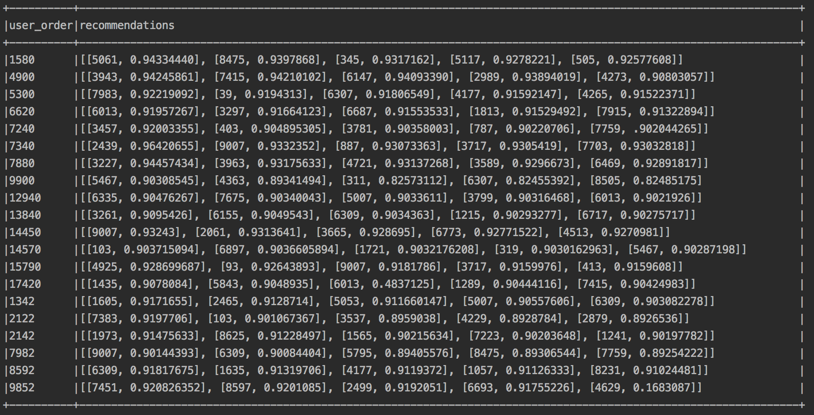
Result
Result list goes here...

Slide 17
Friendly Visualization
According to the result (recommendation list), plot markers on Google Map
Every marker is plotted by longitude and latitude
These are from the result of recommender system, which generates a recommended list for the user
This visualization can apply to any user

Slide 18
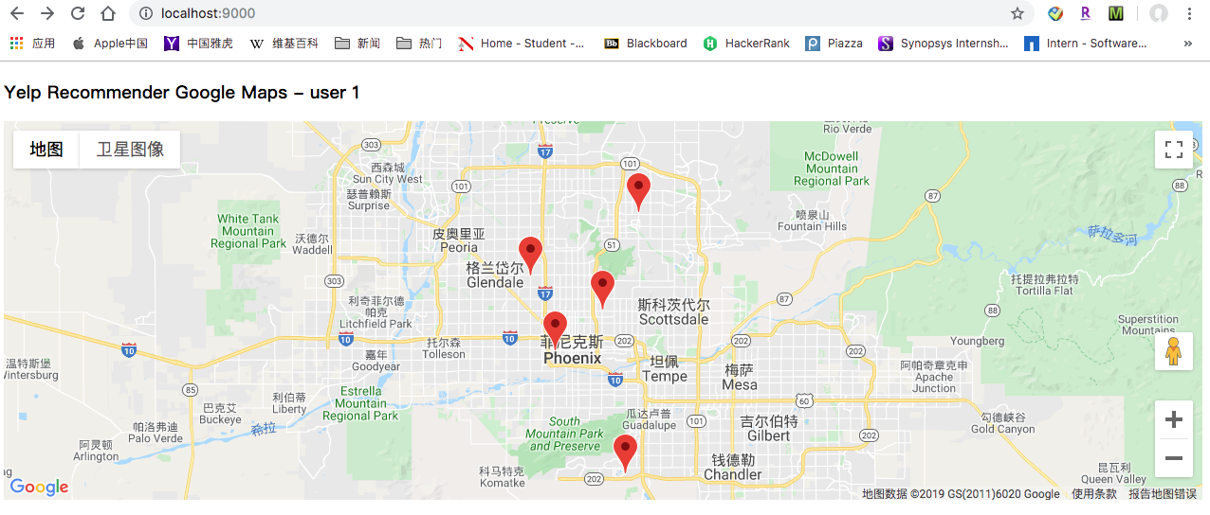
How it display

Slide 19
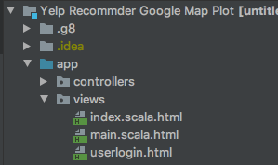
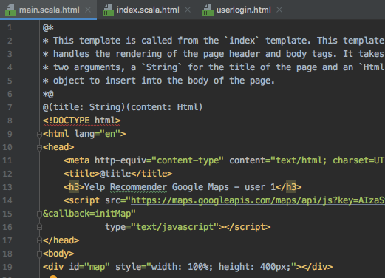
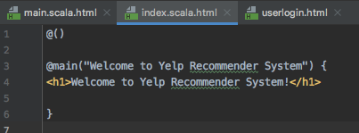
Finished by Play Framework

Slide 20
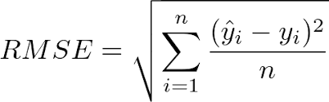
Acceptance criteria
Our main goal is to predict which restaurants users may like. After learning and researching some examples of recommendation systems, we found that RMSE（Root Mean Square Error ）is more popular a criteria. Recall and precision are more for ranking scenarios.
We set down the RMSE that under 1 is acceptable

Slide 21
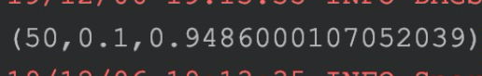
Acceptance criteria
ALS model needs a hyperparameter combined with rank of impicit matrix, rounds of iteration and so on. We implemented grid-search thought to find out the best combination of that. We try lambda 10 times larger every time in order to make the fitting works better. And we set impicit matrix rank in 20, 30, 50.
finally, when we get the best value of RMSE among all input, we know that the model gets a better hyperparameter, like the following screenshot

Slide 22
Potential issues
What if theres a new user comes into this system?
Recommend him of top-n in each cates (Top 10 restaurant 2019)
It does work that if give out a personalized suggestion by his characters when registration, but not necessary.
How to locate a user when calculating the distance?
Choose a pin on maps and suppose that to be a real-time location (Google Map API)
This model can only calculate off-line, which means that is not a real-time solution. We have no idea to deal with it. It’s a natural drawback of this algorithm.

Slide 23
Thank you!

